Slide 1


Slide 2
About Today…
File System Operations
Create
Read
Update
Delete

Slide 3
OPERATIONS

Slide 4
File System Operations
The actions performed on files and directories within a computer's file system
In Node.js, these operations are managed through the built-in 'fs' (File System) module
Importance in node.js
Commonly used for backend development, where file handling is crucial for tasks like reading configuration files, logging data, and managing resources
Enable Node.js applications to interact with files, directories, and file metadata

Slide 5
Common File System Operations in Node.js
Reading Files
Using fs.readFile() to read a text file asynchronously
Using fs.readFileSync () to read a text file synchronously
Writing Files
Using fs.writeFile () to read a text file asynchronously
Using fs.writeFileSync () to read a text file synchronously
Updating Files
Appending data to an existing file using fs.appendFile()
Deleting Files
Deleting a file using fs.unlink()
Creating Directory
Creating a new directory using fs.mkdir()
Removing Directory
Removing a directory using fs.rmdir()

Slide 6
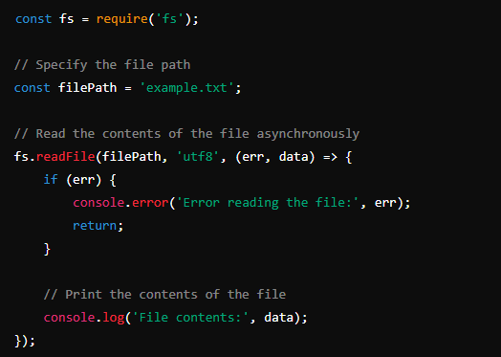
Reading (async) Files in Node.js
fs.readFile():
Asynchronously reads the entire contents of a file

Slide 7
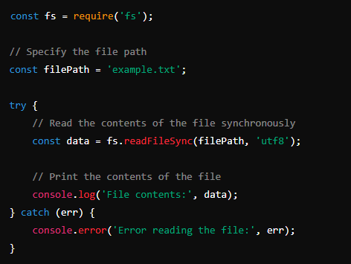
Reading (sync) Files in Node.js
fs.readFileSync():
Synchronously reads the entire contents of a file

Slide 8
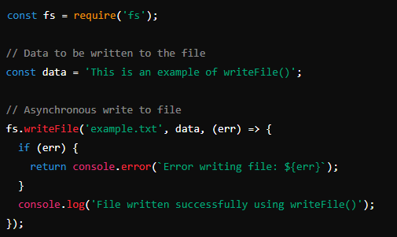
Writing Files in Node.js
fs.writeFile():
Asynchronously writes data to a file, replacing the file if it already exists

Slide 9
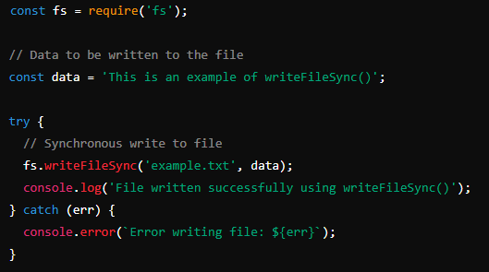
Writing (sync) Files in Node.js
fs.writeFileSync():
Synchronously writes data to a file

Slide 10
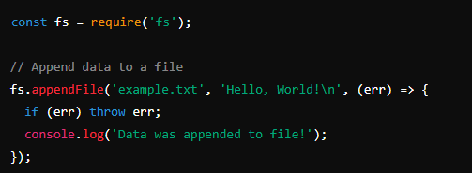
Updating File Contents
fs.appendFile()
Use fs.appendFile() to add data to an existing file

Slide 11
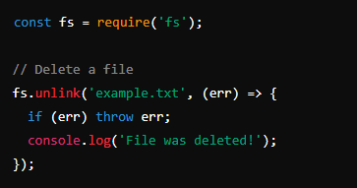
Updating File Contents
fs.unlink()
Use fs.unlink() to delete a file

Slide 12
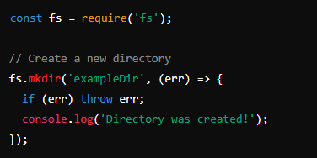
Creating Directories
fs.mkdir()
Use fs.mkdir() to create a new directory.

Slide 13
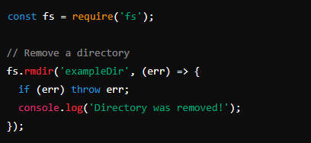
Deleting Directories
fs.rmdir()
Use fs.rmdir() to delete a directory

